Slide 1
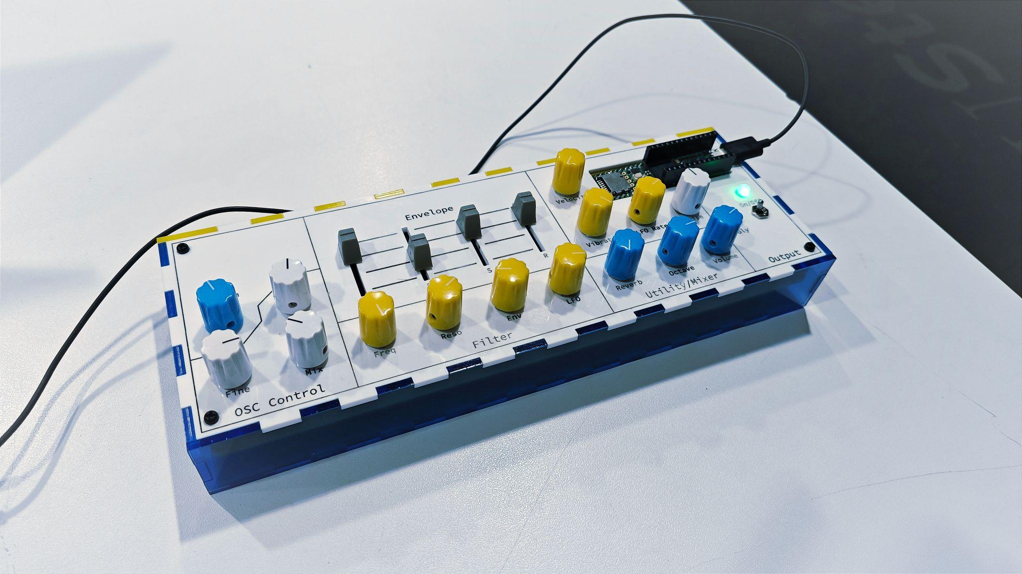
TeensyLab V2
Building a Digital Guitar-to-Synth System Using Max, JUCE and Teensy
Michael Xie, Spring 2024 Capstone Presentation
Advisor: Prof. Steven Litt & Prof. Paul Geluso

Slide 2
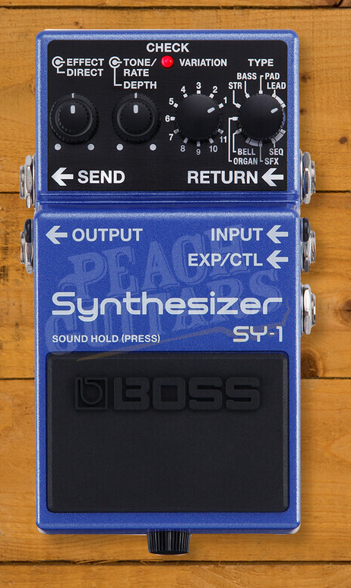
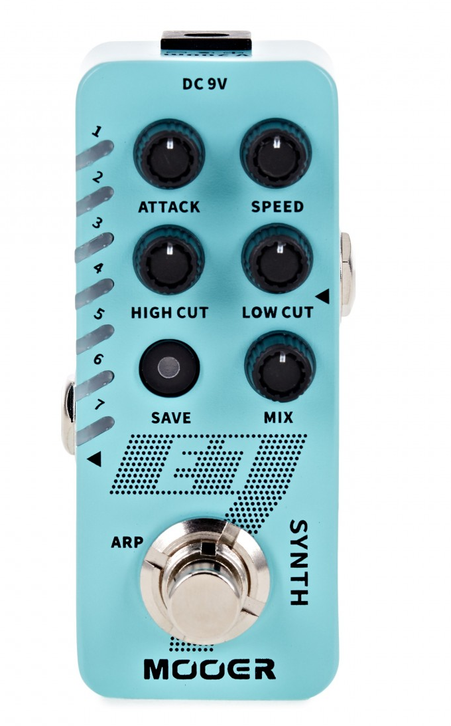
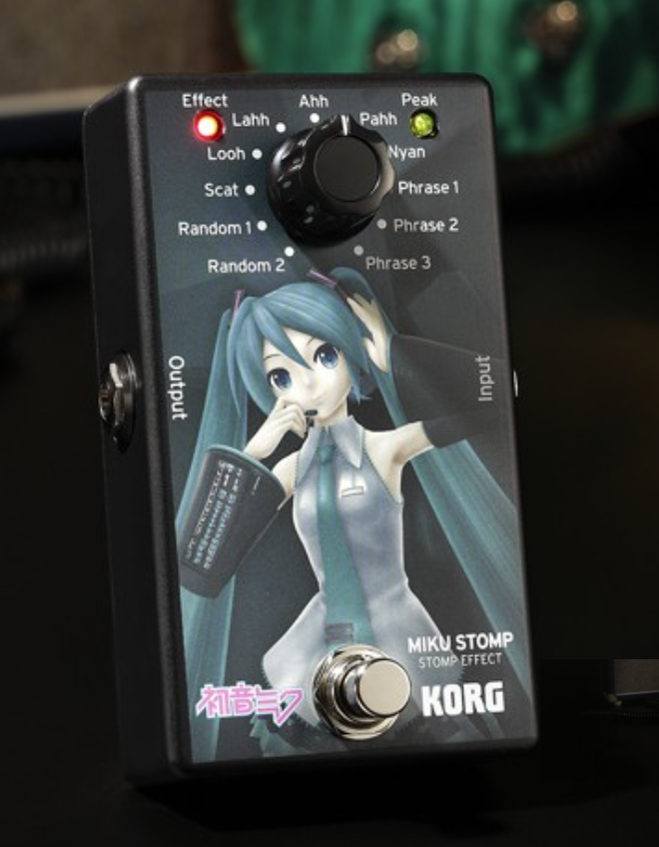
Introduction
Goal: Using the tools learned, build a system mimic the guitar-to-synth pedals. The first inspiration is MIKU KORG, a guitar-to-vocal pedal.
Miku Korg, Mooer E7, BOSS SY-1

Slide 3
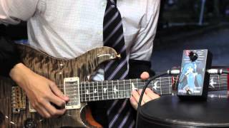
Introduction

Slide 4
Introduction
Method A: F0 detection/estimation -> midi event. YIN algorithm based on autocorrelation method.
Method B: Transformation in the frequency domain.

Slide 5
Project Description
3 Parts:
Max Environment: Pitch Tracker Module, host for the vst.
The VST plugin: JX11 plugin, a 2 voice sawtooth virtual analog synth.
Hardware teensy control interface: Midi controller built with Teensy, a prototype with Printed Circuit Board and laser-cut box.
Max
Guitar In
Pitch Tracker
JX11 VST
Audio Out
Teensy

Slide 6
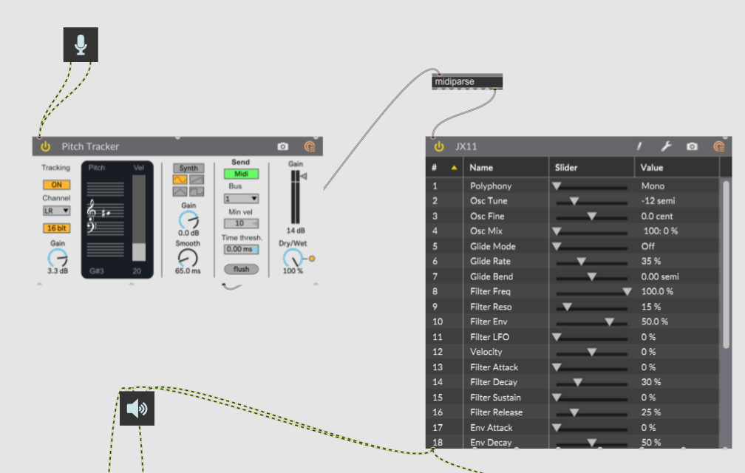
Max Environment

Slide 7
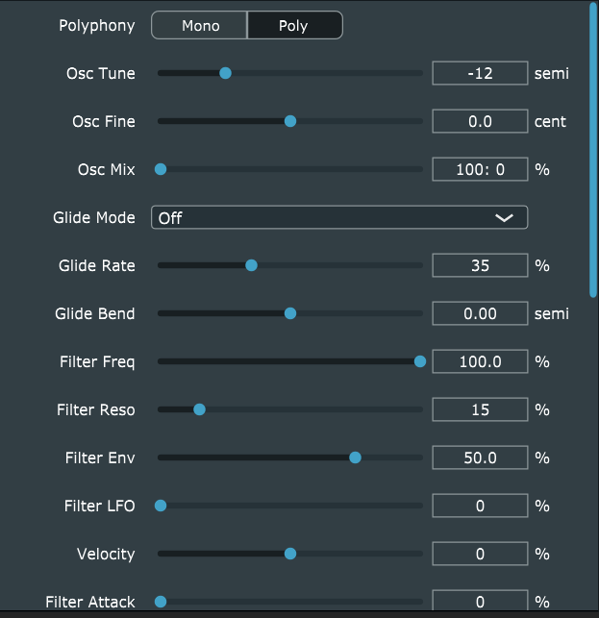
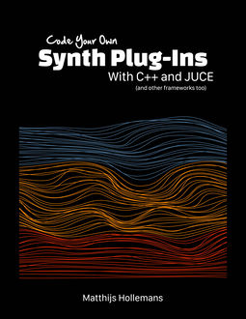
The JX11 VST Plugin

Slide 8
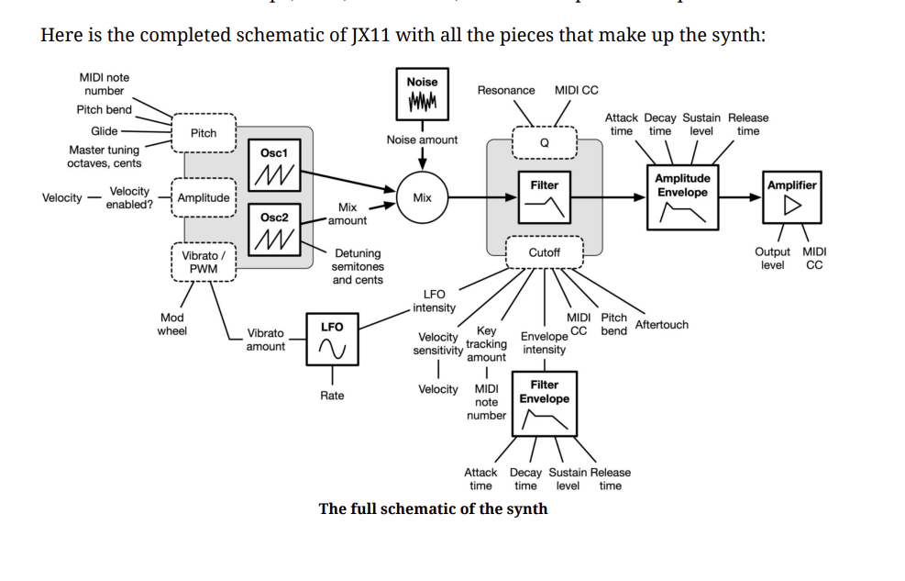
The JX11 VST Plugin

Slide 9
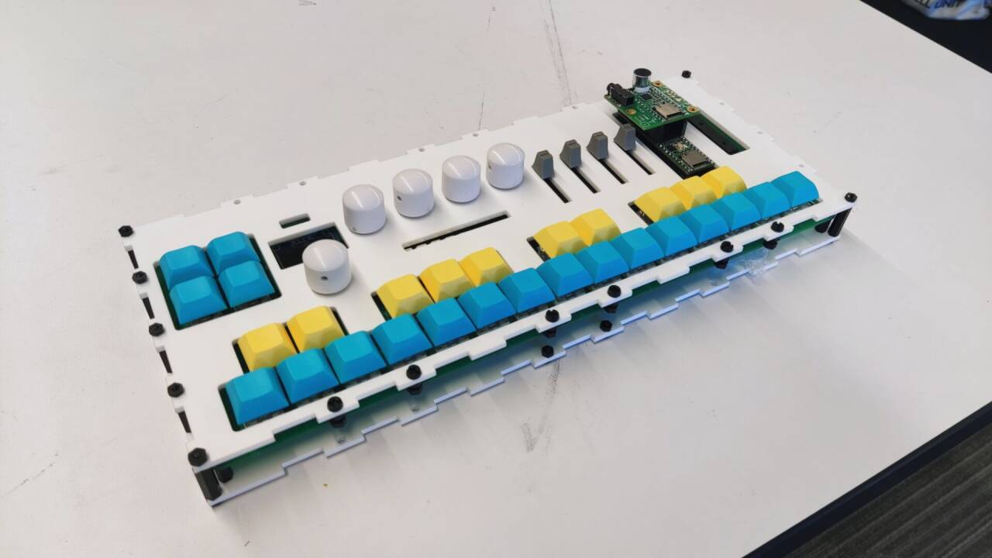
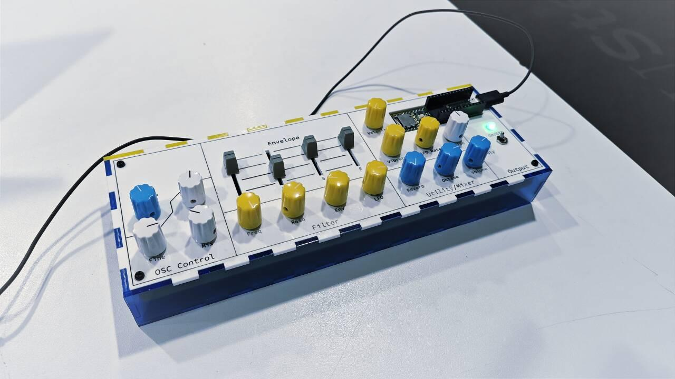
Control Interface with Teensy

Slide 10
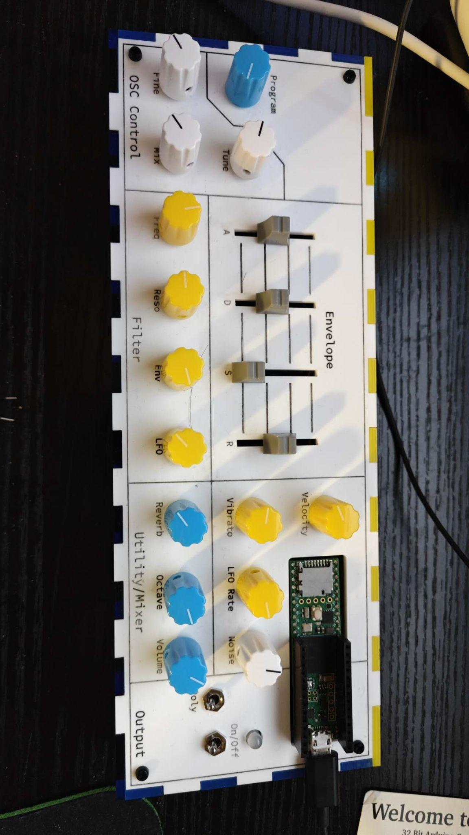
Control Interface with Teensy
Encoder * 1
Potentiometer * 18
2 Switches
Neopixel LED

Slide 11
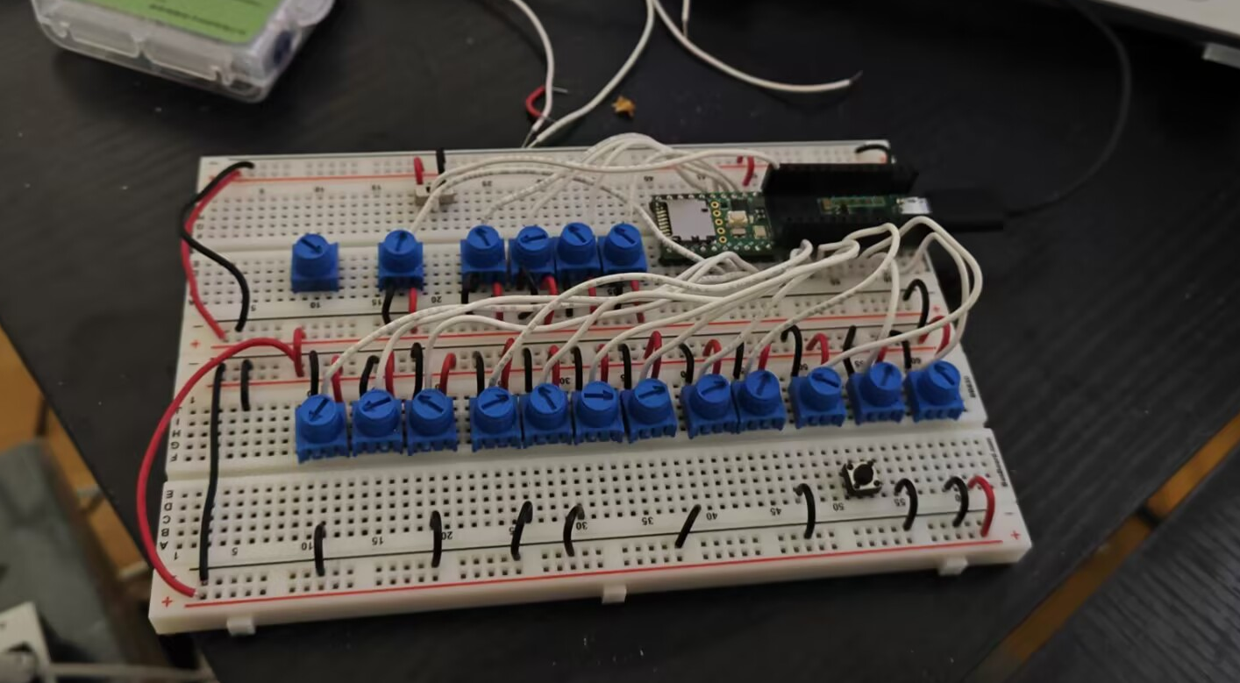
Control Interface with Teensy
Encoder * 1
Potentiometer * 18
2 Switches
Neopixel LED

Slide 12
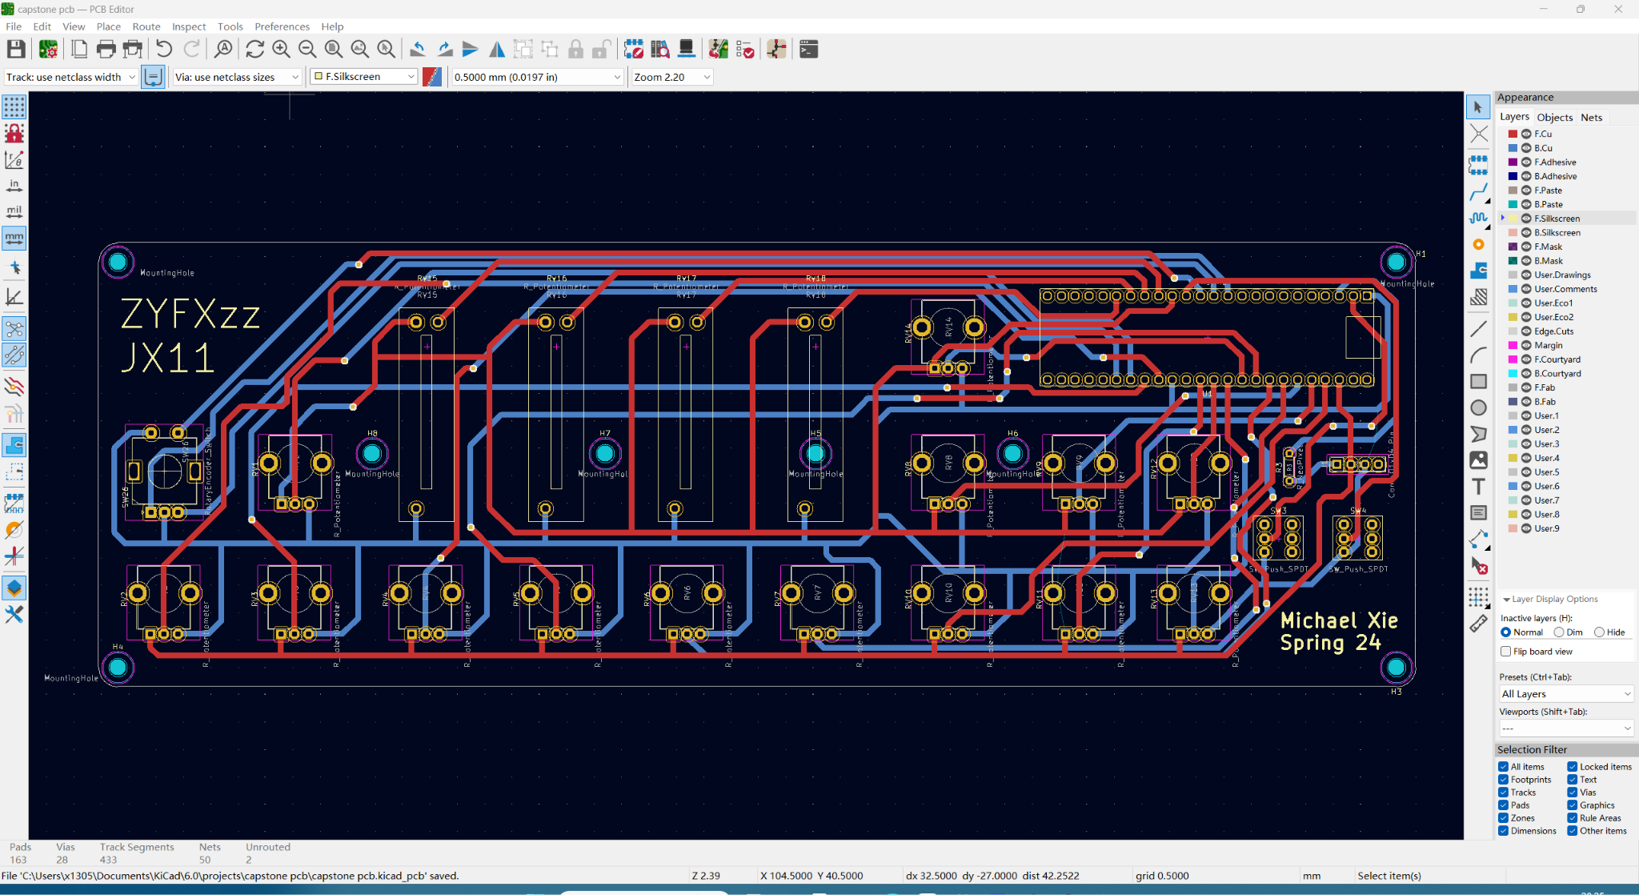
Control Interface with Teensy
Encoder * 1
Potentiometer * 18
2 Switches
Neopixel LED

Slide 13
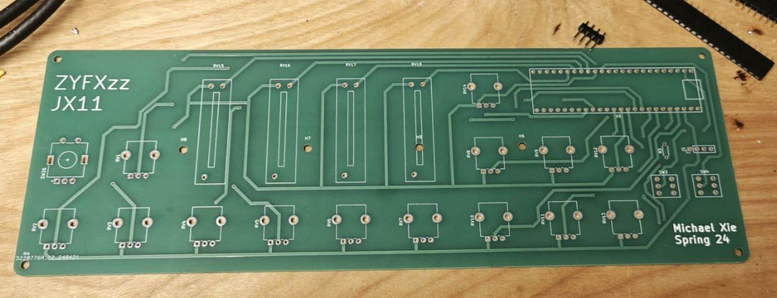
Control Interface with Teensy
Encoder * 1
Potentiometer * 18
2 Switches
Neopixel LED

Slide 14
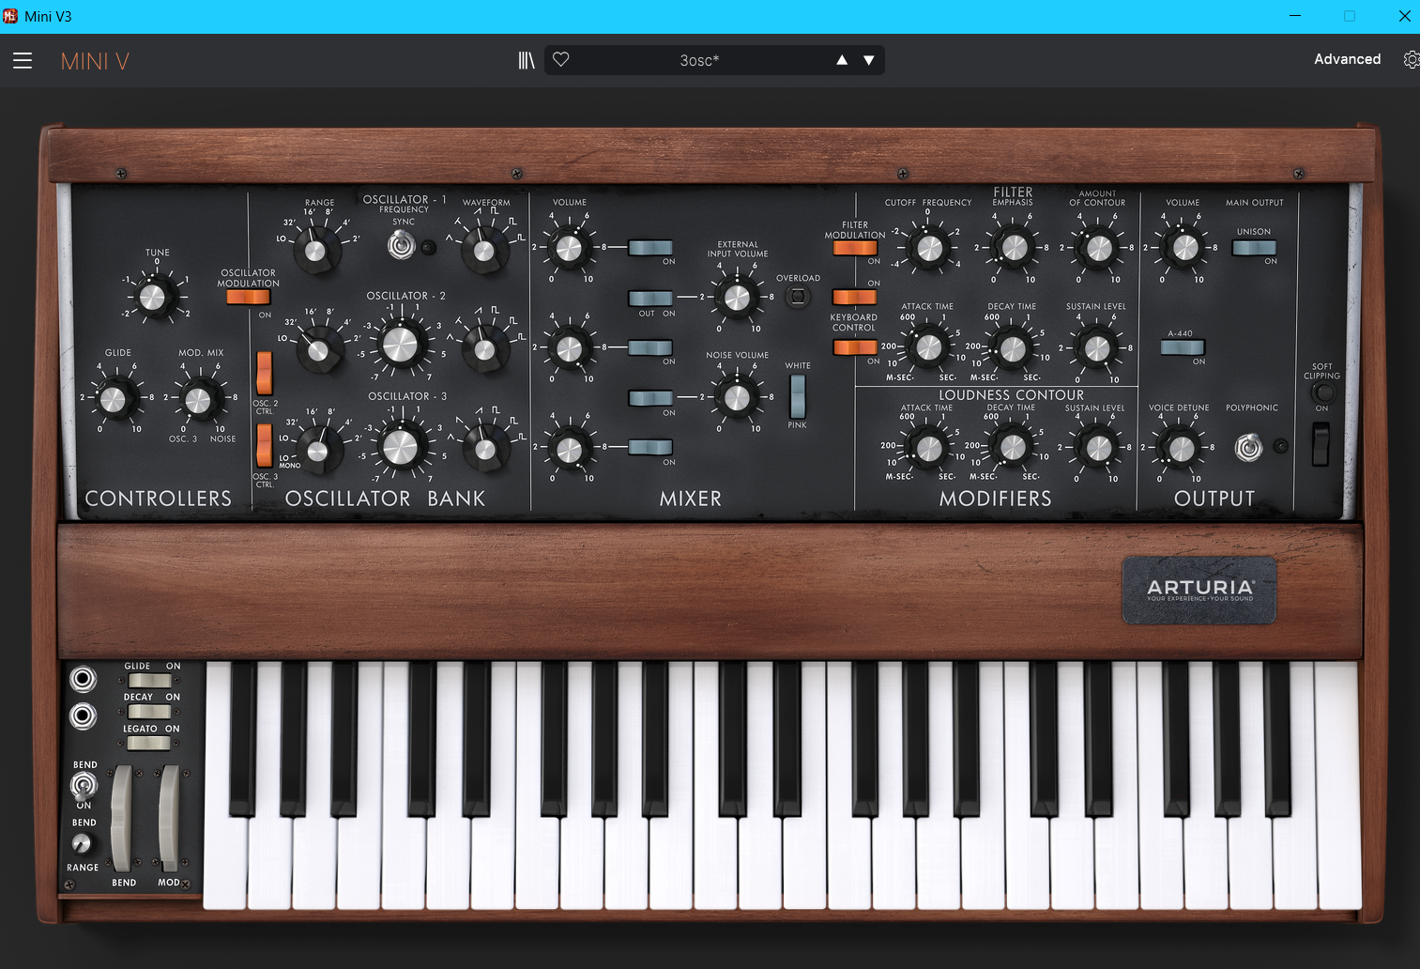
Control Interface with Teensy

Slide 15
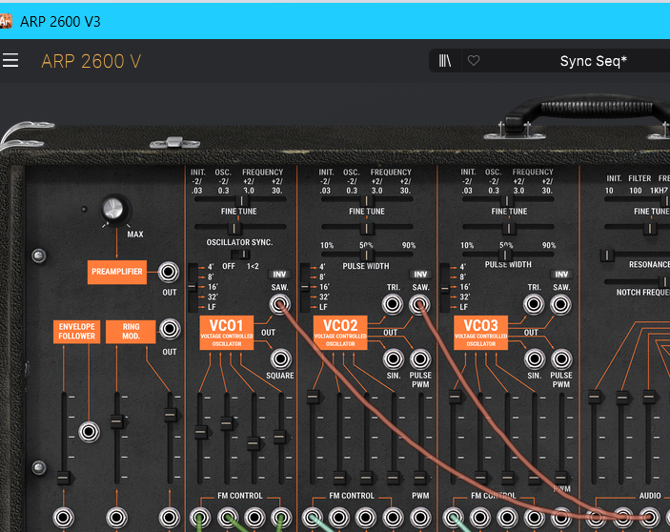
Control Interface with Teensy

Slide 16
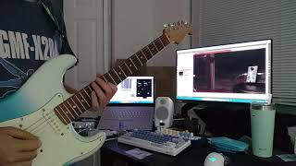
Demo

Slide 17
Future Work
Add sample-based synthesis, which was expected to accomplish when proposing the project.
Improve pitch tracking: using other tools available, midi debounce mechanism, distinguish between a new note event and vibrato/pitch bending.
Expand max patch, put in midi effects. A note in, a chord out.
Machine Learning Timbre transfer, DDSP from Google Magenta. With ML, DDSP can transform bird singing to violin playing.

Slide 18
Conclusion
A better understanding of structure/life-cycle of an audio plugin
A continue practice of electronics
A good summary of my study in the undergrad program
A stepping stone for future work in the master

Slide 19
Thank you!

Slide 20
Reference
Alain de Cheveigne, and Hideki Kawahara. “Yin, a Fundamental Frequency Estimator for Speech and Music.” Http://Audition.Ens.Fr/Adc/Pdf/2002_JASA_YIN.Pdf, audition.ens.fr/adc/pdf/2002_JASA_YIN.pdf. Accessed 11 Dec. 2023.
Roads, Curtis. The Computer Music Tutorial. The MIT Press, 2023.
Hollemans, Matthijs. Code Your Own Synth Plug-Ins with C++ and JUCE. Independently Published, 2023.
Pirkle, William C. Designing Audio Effect Plugins in C++: For AAX, AU, and VST3 with DSP Theory. Routledge, 2019.

